Slide 1

Introduction to Neural Networks
Learning like a human
Yordan Darakchiev
Technical Trainer
iordan93@gmail.com

Slide 2
sli.do #MachineLearning

Slide 3
Table of Contents
Neural networks
Overview
Problem statement
Pros and cons
Perceptron
Feed-forward NNs (multi-layer perceptrons)
Training
Applications for classification

Slide 4
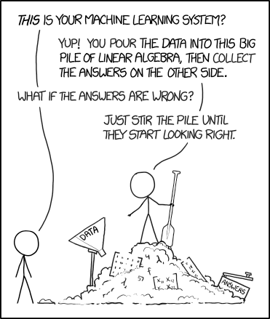
Before We Start…

Slide 5
Neural Networks
Combining simple algorithms to achieve glory

Slide 6
Neural Networks
Neural networks try to mimic the way the human brain works
Series of interconnected artificial neurons (perceptrons)
Can do classification, regression, unsupervised learning, etc.
Perceptrons were "invented" in the 1940s
Great development in the recent years
"Deep learning" – ML algorithms using neural networks
Cutting-edge applications
Machine translation
Speech recognition and generation
Image recognition
Game playing, etc.
Some examples of deep learning applications

Slide 7
Neural Networks: Pros and Cons
Can be used to model any datasets
Arbitrary dataset complexity
One type of algorithm can be used for many applications
Do not provide any interpretability
The classification boundaries are hard to interpret
The model is mostly "black box"
NNs are not probabilistic (we can't get a confidence metric)
"The Dark Secrets at the Heart of AI"
Solutions: trying to explain decisions, combining with other algorithms, etc.
Can be slow
Other models usually train a lot faster, even if we use special hardware
NNs are not a substitute for understanding the problem deeply

Slide 8
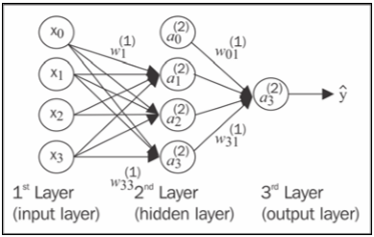
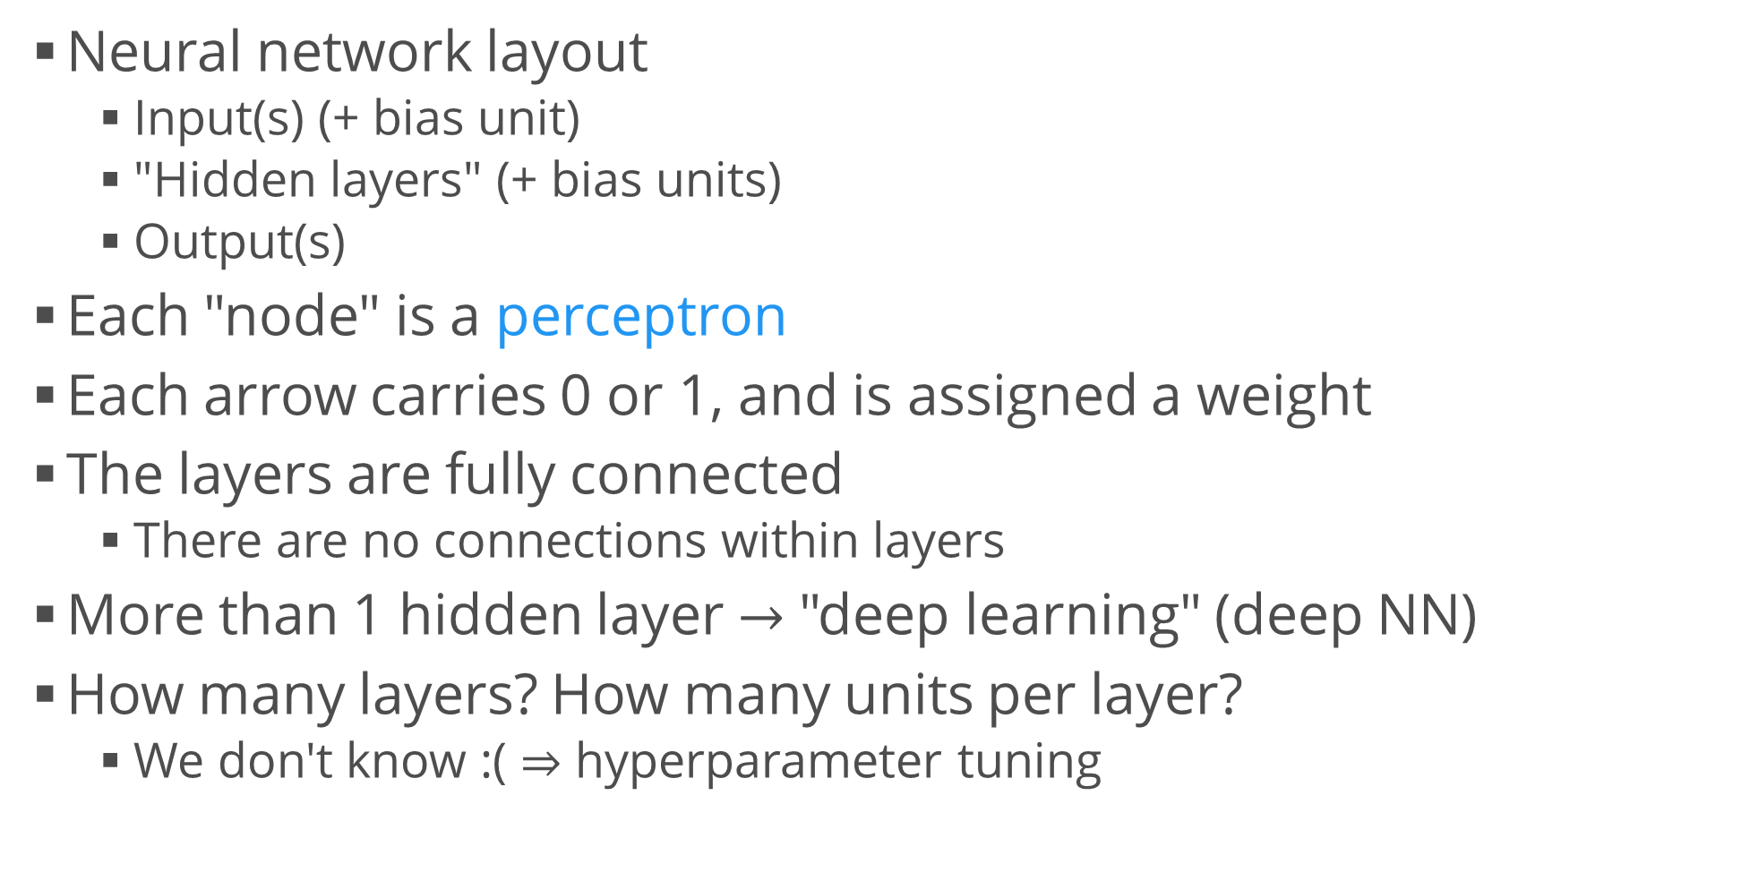
Neural Network Architecture
Neural network layout
Input(s) (+ bias unit)
"Hidden layers" (+ bias units)
Output(s)
Each "node" is a perceptron
Each arrow carries 0 or 1, and is assigned a weight
The layers are fully connected
There are no connections within layers
More than 1 hidden layer $→$ "deep learning" (deep NN)
How many layers? How many units per layer?
We don't know :( $⇒$ hyperparameter tuning

Slide 9
Neural Network Learning
The type of NN we look at is called a "feed-forward NN"
Data flows only forward, there are no "back-links"
Learning algorithm:
Forward propagation / backpropagation
Using the data, propagate the patterns from input to output
Based on the output, calculate the error (using a cost function)
Backpropagate the error (using derivatives), update the model
We get the "final" weights after repeating the process for several epochs
The math is a bit ugly
You can read an explanation here

Slide 10
Neural Network Learning (2)
Classification: just use one-hot encoding
MLP = multi-layer perceptron
Regression: no activation function at the output layer
Regularization: parameter alpha
Increasing = less overfitting
A visual comparison of regularization parameters
Tips
A neural network is very sensitive to feature scaling
[0; 1], [-1; 1] or Z
Use a scaler, e.g. StandardScaler
Use fine-tuning to optimize alpha
Usually in the range 10.0 ** -np.arange(1, 7)
from sklearn.neural_network import MLPClassifier
from sklearn.neural_network import MLPRegressor

Slide 11
Example: Classifying Handwritten Digits
Obtain the MNIST dataset of handwritten digits
This is a famous dataset for learning and comparing neural networks
Each data point represents a 28 x 28 image of a digit (0 – 9)
Train a simple NN on the MNIST dataset
Choose a reasonable number of layers and units per layer, e.g. {3, 3}
Test, score and evaluate the classification performance
E.g. accuracy, precision, recall, F1, confusion matrix, ROC curve
* Try several other architectures (e.g. more layers, more units per layer, different structure, e.g. 2 + 3 + 2 units, etc.)
* Compare the results with (an)other classifier(s), e.g. SVM

Slide 12
Neural Network Implementation
Achieving glory… just a little bit harder

Slide 13


Slide 14
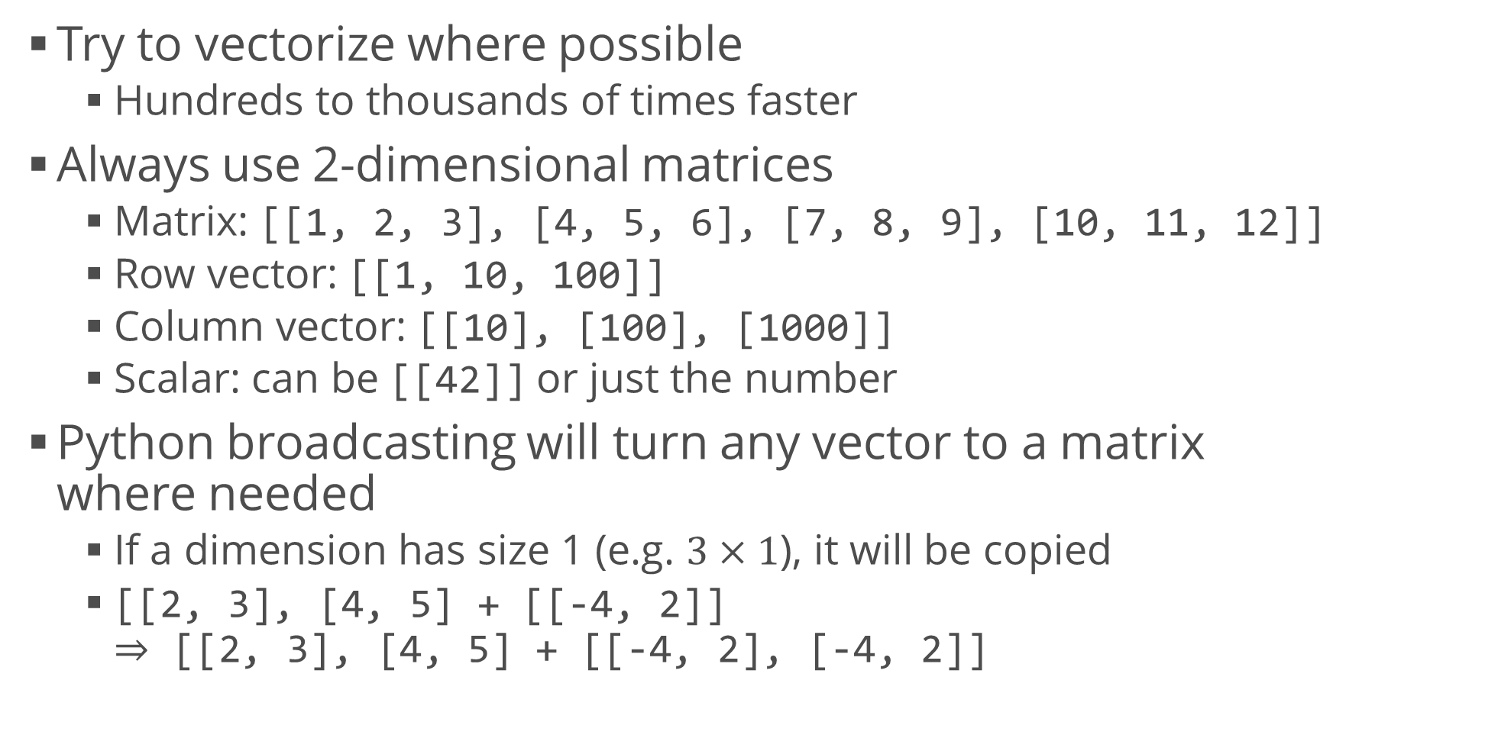
Conventions
Try to vectorize where possible
Hundreds to thousands of times faster
Always use 2-dimensional matrices
Matrix: [[1, 2, 3], [4, 5, 6], [7, 8, 9], [10, 11, 12]]
Row vector: [[1, 10, 100]]
Column vector: [[10], [100], [1000]]
Scalar: can be [[42]] or just the number
Python broadcasting will turn any vector to a matrix where needed
If a dimension has size 1 (e.g. $3×1$), it will be copied
[[2, 3], [4, 5] + [[-4, 2]] $⇒$ [[2, 3], [4, 5] + [[-4, 2], [-4, 2]]

Slide 15
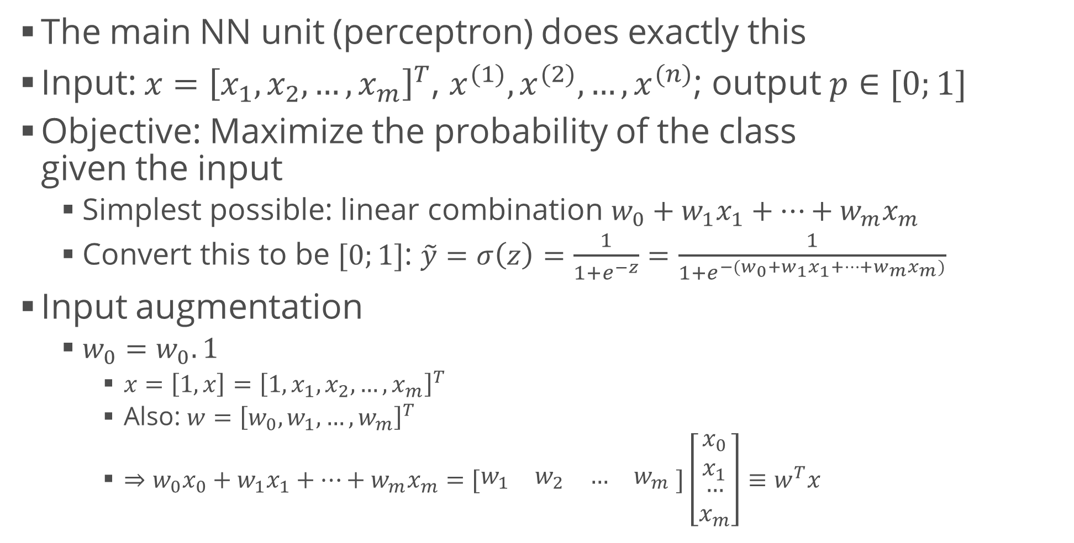
Review: Logistic Regression
The main NN unit (perceptron) does exactly this
Input: $x={\left[x_{1},x_{2}, …, x_{m}\right]}^{T}$, $x^{(1)}, x^{(2)}, …, x^{(n)}$; output $p∈[0;1]$
Objective: Maximize the probability of the class given the input
Simplest possible: linear combination $w_{0}+w_{1}x_{1}+…+w_{m}x_{m}$
Convert this to be $[0;1]$: $\tilde{y}=σ\left(z\right)=\frac{1}{1+e^{−z}}=\frac{1}{1+e^{−(w_{0}+w_{1}x_{1}+…+w_{m}x_{m})}}$
Input augmentation
$w_{0}=w_{0}.1$
$x=\left[1, x\right]={\left[1, x_{1}, x_{2}, …, x_{m}\right]}^{T}$
Also: $w={\left[w_{0}, w_{1}, …, w_{m}\right]}^{T}$
$⇒w_{0}x_{0}+w_{1}x_{1}+…+w_{m}x_{m}=[\begin{matrix}w_{1} & w_{2} & … & w_{m}\end{matrix} ]\left[\begin{matrix}x_{0} \\ x_{1} \\ \begin{aligned}… \\ x_{m}\end{aligned}\end{matrix}\right]$ $≡w^{T}x$

Slide 16
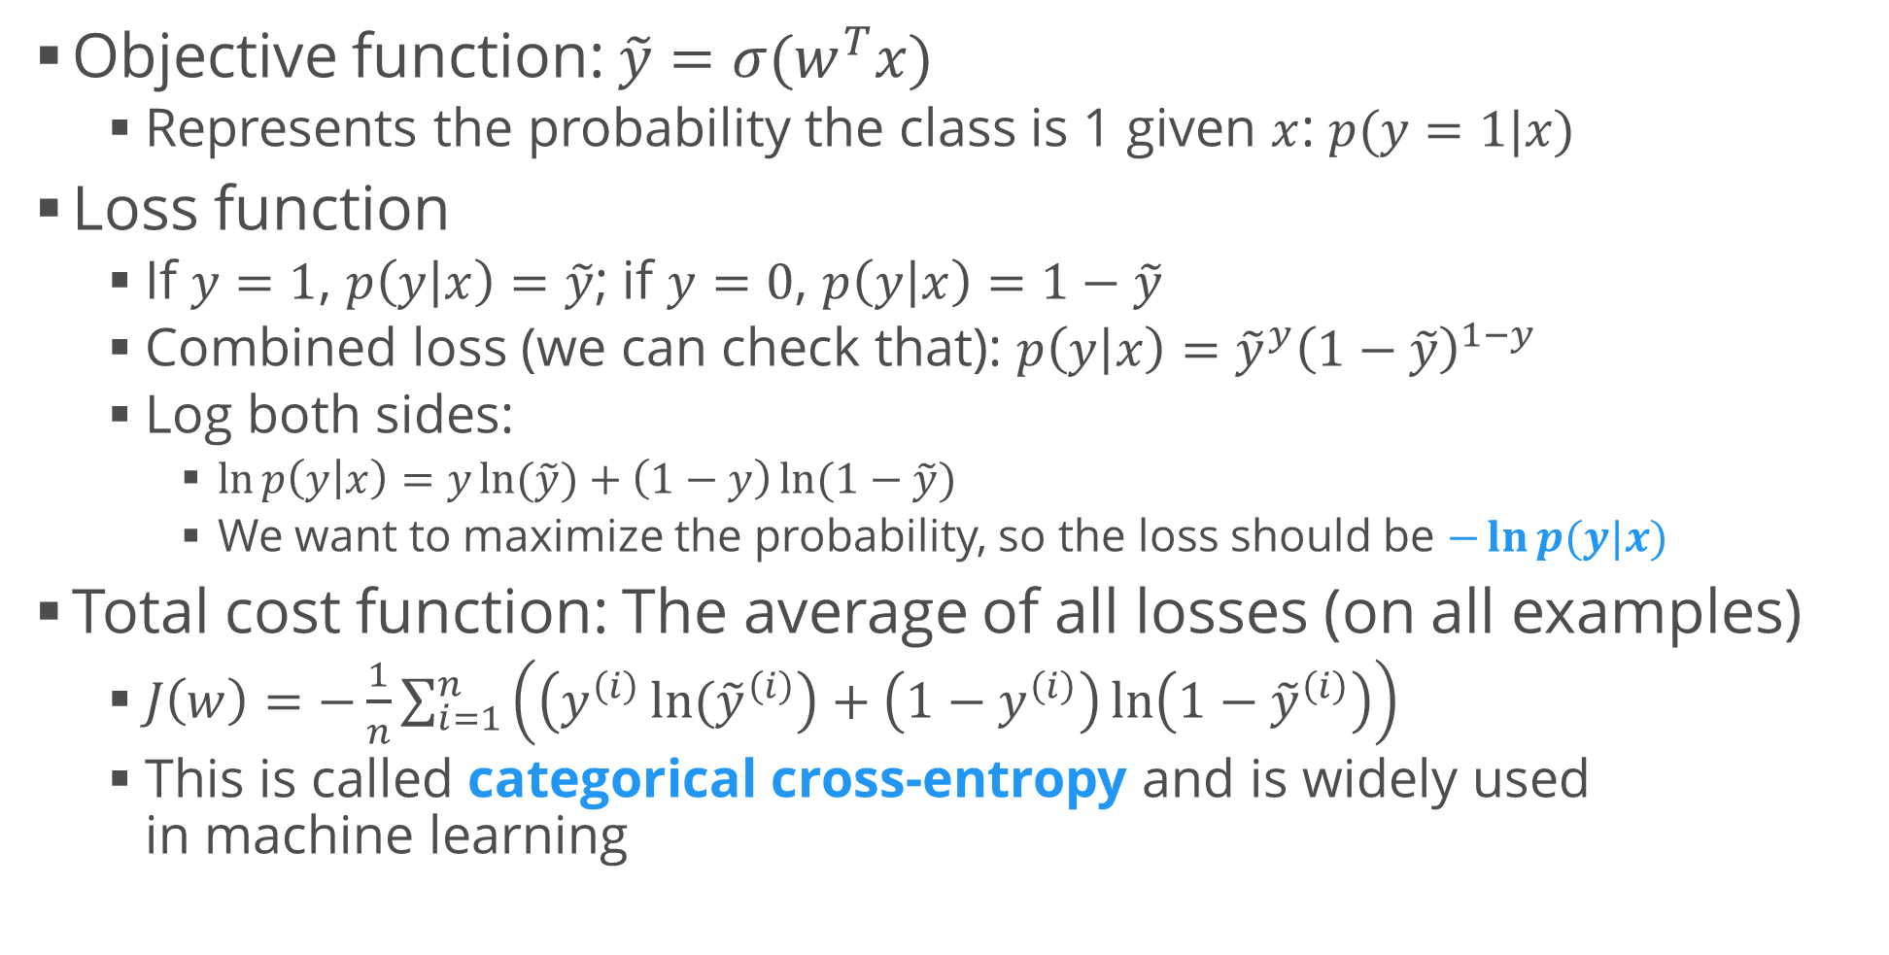
Review: Logistic Regression (2)
Objective function: $\tilde{y}=σ(w^{T}x)$
Represents the probability the class is 1 given $x$: $p(y=1|x)$
Loss function
If $y=1$, $p\left(y | x\right)=\tilde{y}$; if $y=0$, $p\left(y | x\right)=1−\tilde{y}$
Combined loss (we can check that): $p\left(y | x\right)={\tilde{y}}^{y}{\left(1−\tilde{y}\right)}^{1−y}$
Log both sides:
$\ln{p\left(y | x\right)=y\ln{(\tilde{y}})+\left(1−y\right)\ln{(1−\tilde{y})}}$
We want to maximize the probability, so the loss should be $−\ln{p(y|x)}$
Total cost function: The average of all losses (on all examples)
$J\left(w\right)=−\frac{1}{n}\sum_{i=1}^{n}{\left(\left(y^{\left(i\right)}\ln{({\tilde{y}}^{\left(i\right)}}\right)+\left(1−y^{\left(i\right)}\right)\ln\left(1−{\tilde{y}}^{\left(i\right)}\right)\right)}$
This is called categorical cross-entropy and is widely used in machine learning

Slide 17









Computation Graphs
Overview
A useful representation of computation sequences
Good not only for visualization
Almost every compiler / interpreter has some implementation
Example: logistic regression
Why is a graph so useful?
We need to know the derivatives of the last quantity
To compute them, we just need to go back
$$x$$
$$w^{T}x$$
$$σ(w^{T}x)$$
$$\tilde{y}$$
$$Loss(y, \tilde{y})$$
$$J(w)$$
$$w$$
$$w^{T}$$
$$y$$

Slide 18



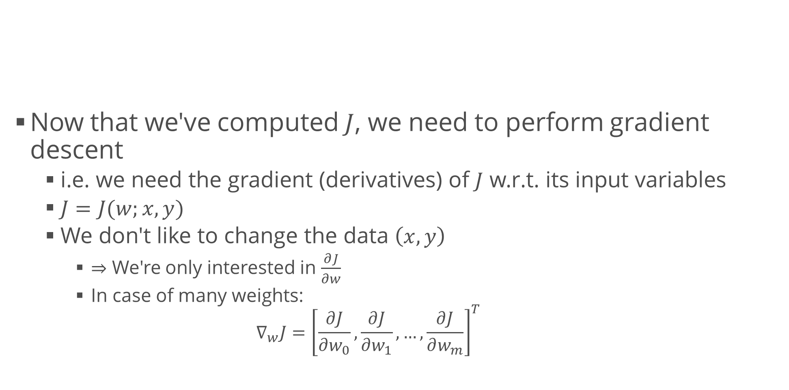





Gradients on Computational Graphs
$$x$$
Now that we've computed $J$, we need to perform gradient descent
i.e. we need the gradient (derivatives) of $J$ w.r.t. its input variables
$J=J(w;x,y)$
We don't like to change the data $\left(x,y\right)$
$⇒$ We're only interested in $\frac{∂J}{∂w}$
In case of many weights:
$$∇_{w}J={\left[\frac{∂J}{∂w_{0}},\frac{∂J}{∂w_{1}},…,\frac{∂J}{∂w_{m}}\right]}^{T}$$
$$z=w^{T}x$$
$$\tilde{y}=σ(z)$$
$$L(y, \tilde{y})$$
$$J(w)$$
$$w$$
$$w^{T}$$
$$y$$

Slide 19


Gradients on Computational Graphs (2)
$$x$$
Solution: Chain rule
For the function $f(g\left(x\right))$, $\frac{df}{dx}=\frac{df}{dg}\frac{dg}{dx}$
$J=−\frac{1}{n}∑L^{\left(i\right)}$
$L\left(y, \tilde{y}\right)=y\ln{(\tilde{y}})+\left(1−y\right)\ln{(1−\tilde{y})}$
$\frac{∂L}{∂\tilde{y}}=\frac{y}{\tilde{y}}−\frac{1−y}{1−\tilde{y}}$
$$z=w^{T}x$$
$$\tilde{y}=σ(z)$$
$$L(y, \tilde{y})$$
$$J(w)$$
$$w$$
$$w^{T}$$
$$y$$
$$\frac{∂L}{∂\tilde{y}}$$

Slide 20

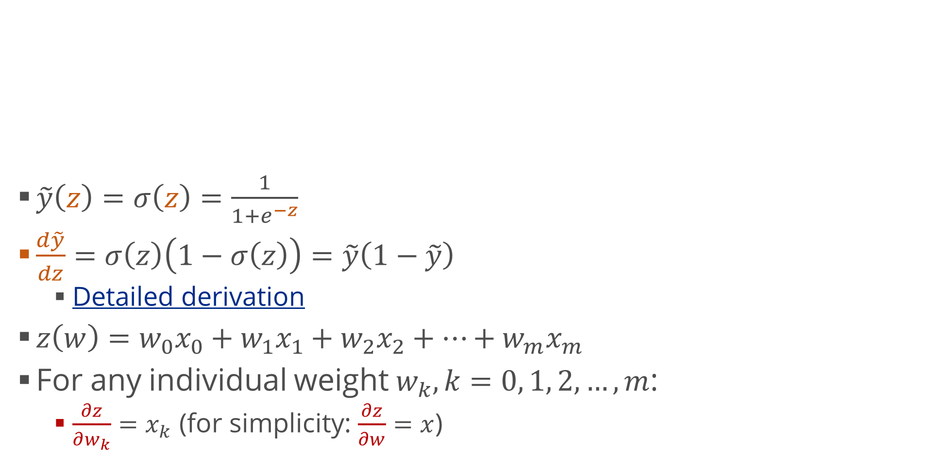

Gradients on Computational Graphs (3)
$$x$$
$\tilde{y}\left(z\right)=σ\left(z\right)=\frac{1}{1+e^{−z}}$
$\frac{d\tilde{y}}{dz}=σ\left(z\right)\left(1−σ\left(z\right)\right)=\tilde{y}\left(1−\tilde{y}\right)$
Detailed derivation
$z\left(w\right)=w_{0}x_{0}+w_{1}x_{1}+w_{2}x_{2}+…+w_{m}x_{m}$
For any individual weight $w_{k},k=0, 1, 2, …, m$:
$\frac{∂z}{∂w_{k}}=x_{k}$ (for simplicity: $\frac{∂z}{∂w}=x$)
$$z=w^{T}x$$
$$\tilde{y}=σ(z)$$
$$L(y, \tilde{y})$$
$$J(w)$$
$$w$$
$$w^{T}$$
$$\frac{∂z}{∂w}$$
$$\frac{∂\tilde{y}}{∂z}$$
$$y$$
$$\frac{∂L}{∂\tilde{y}}$$

Slide 21
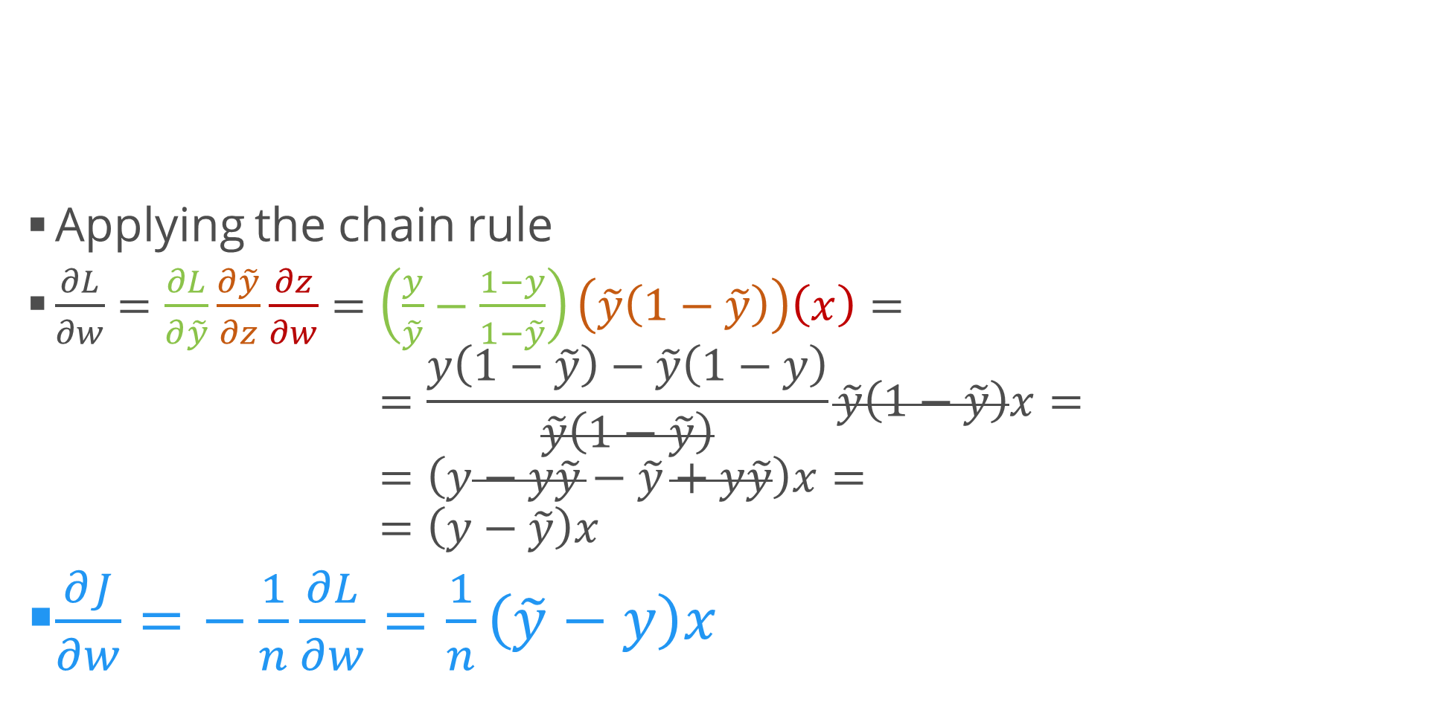
Gradients on Computational Graphs (4)
$$x$$
Applying the chain rule
$\frac{∂L}{∂w}=\frac{∂L}{∂\tilde{y}}\frac{∂\tilde{y}}{∂z}\frac{∂z}{∂w}=\left(\frac{y}{\tilde{y}}−\frac{1−y}{1−\tilde{y}}\right)\left(\tilde{y}\left(1−\tilde{y}\right)\right)\left(x\right)=$ $=\frac{y\left(1−\tilde{y}\right)−\tilde{y}\left(1−y\right)}{\tilde{y}\left(1−\tilde{y}\right)}\tilde{y}\left(1−\tilde{y}\right)x=$ $=\left(y−y\tilde{y}−\tilde{y}+y\tilde{y}\right)x=$ $=\left(y−\tilde{y}\right)x$
$\frac{∂J}{∂w}=−\frac{1}{n}\frac{∂L}{∂w}=\frac{1}{n}\left(\tilde{y}−y\right)x$
$$z=w^{T}x$$
$$\tilde{y}=σ(z)$$
$$L(y, \tilde{y})$$
$$J(w)$$
$$w$$
$$w^{T}$$
$$\frac{∂z}{∂w}$$
$$\frac{∂\tilde{y}}{∂z}$$
$$y$$
$$\frac{∂L}{∂\tilde{y}}$$

Slide 22
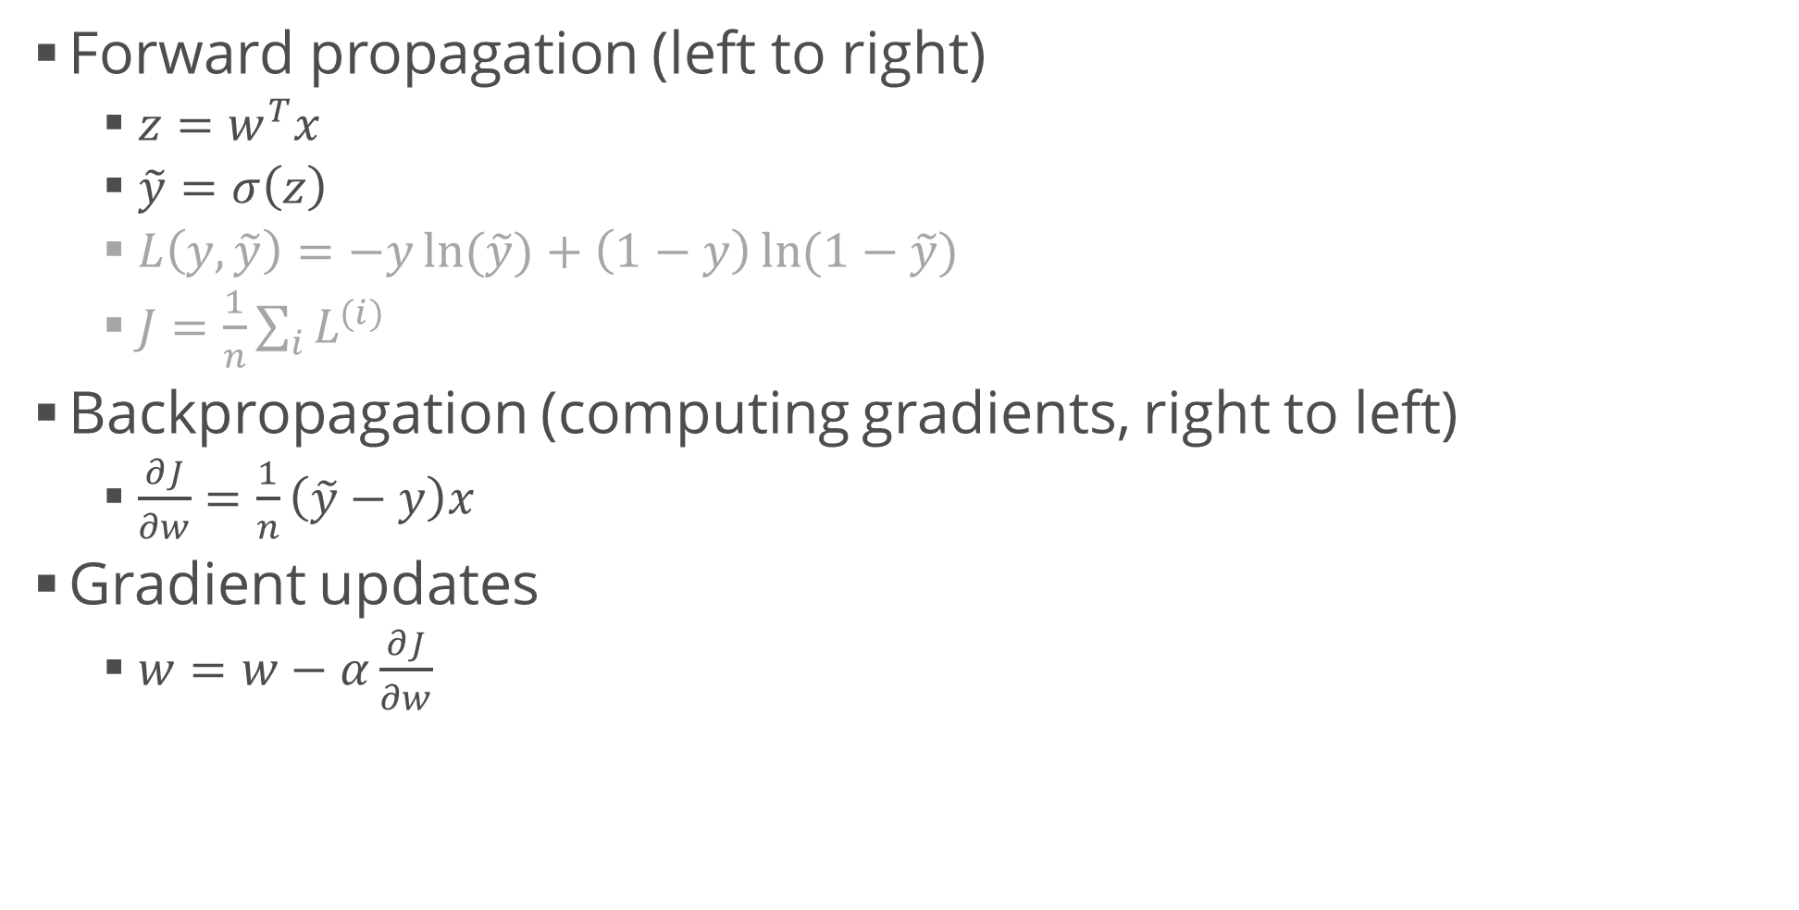
Putting It All Together
Forward propagation (left to right)
$z=w^{T}x$
$\tilde{y}=σ\left(z\right)$
$L\left(y, \tilde{y}\right)=−y\ln{(\tilde{y}})+\left(1−y\right)\ln{(1−\tilde{y})}$
$J=\frac{1}{n}\sum_{i}{L^{(i)}}$
Backpropagation (computing gradients, right to left)
$\frac{∂J}{∂w}=\frac{1}{n}\left(\tilde{y}−y\right)x$
Gradient updates
$w=w−α\frac{∂J}{∂w}$

Slide 23
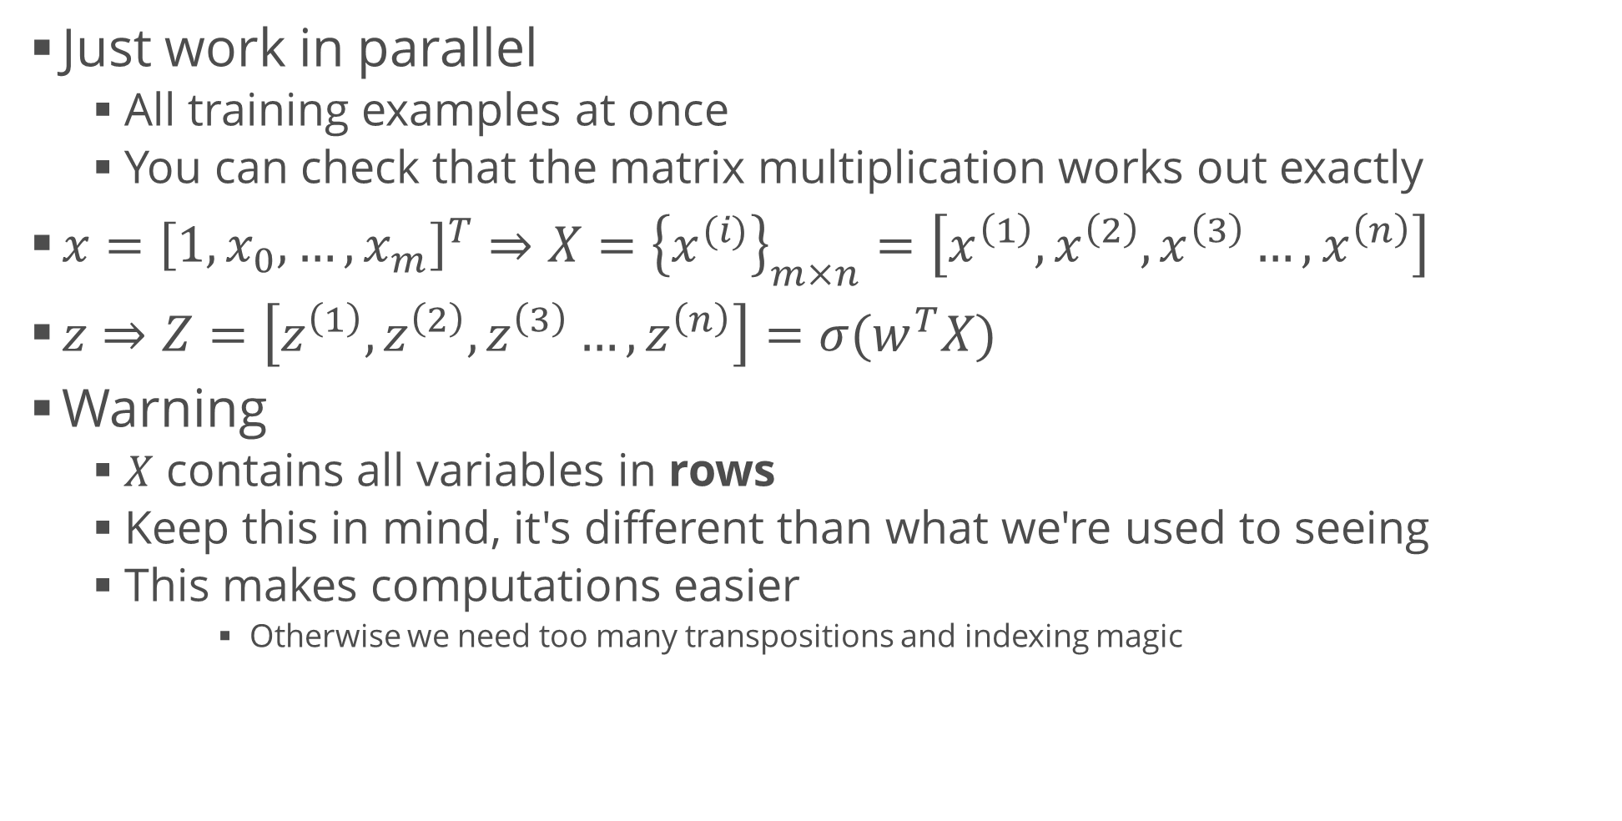
Generalization: Many Examples
Just work in parallel
All training examples at once
You can check that the matrix multiplication works out exactly
$x={\left[1, x_{0},…,x_{m}\right]}^{T}⇒X={\left\{x^{(i)}\right\}}_{m×n}=\left[x^{\left(1\right)}, x^{\left(2\right)}, x^{\left(3\right)}…, x^{\left(n\right)}\right]$
$z⇒Z=\left[z^{\left(1\right)}, z^{\left(2\right)}, z^{\left(3\right)}…, z^{\left(n\right)}\right]=σ(w^{T}X)$
Warning
$X$ contains all variables in rows
Keep this in mind, it's different than what we're used to seeing
This makes computations easier
Otherwise we need too many transpositions and indexing magic

Slide 24



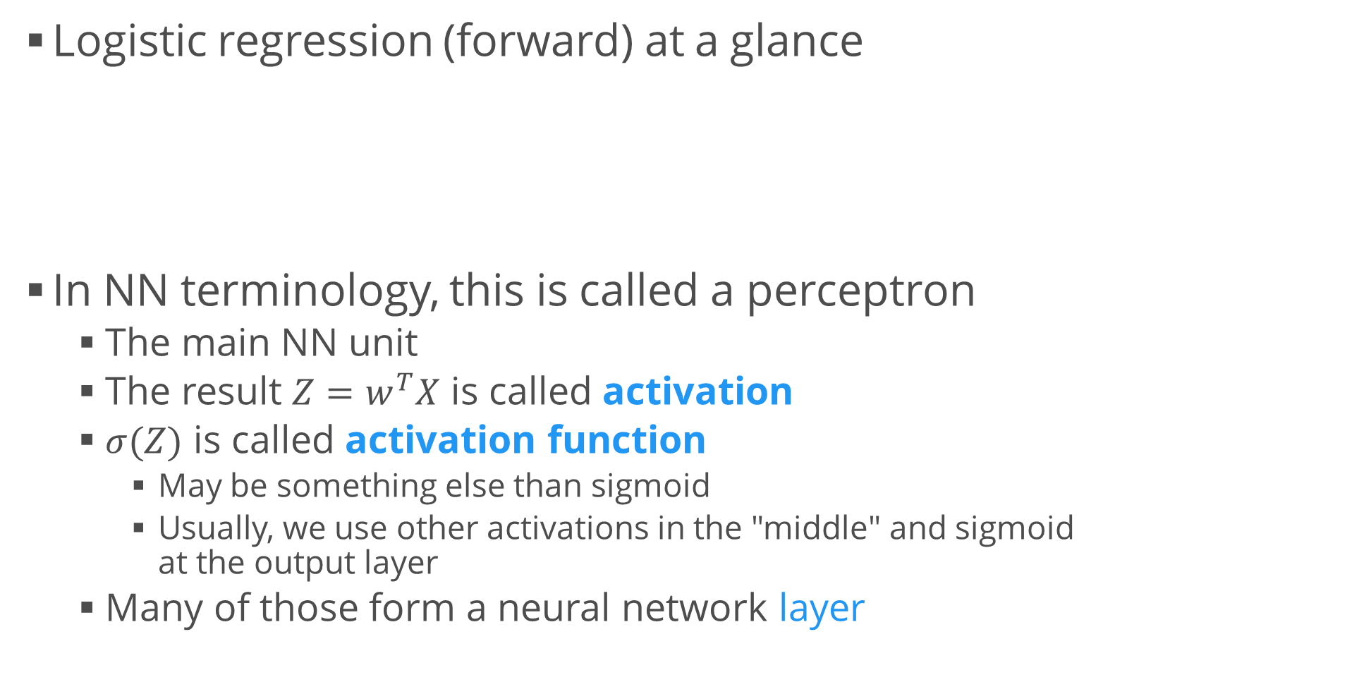



Perceptron
Logistic regression (forward) at a glance
In NN terminology, this is called a perceptron
The main NN unit
The result $Z=w^{T}X$ is called activation
$σ(Z)$ is called activation function
May be something else than sigmoid
Usually, we use other activations in the "middle" and sigmoid at the output layer
Many of those form a neural network layer
$$x_{1}$$
$$x_{2}$$
$$Σ$$
$$σ$$
$$\tilde{y}$$
$$x_{3}$$

Slide 25
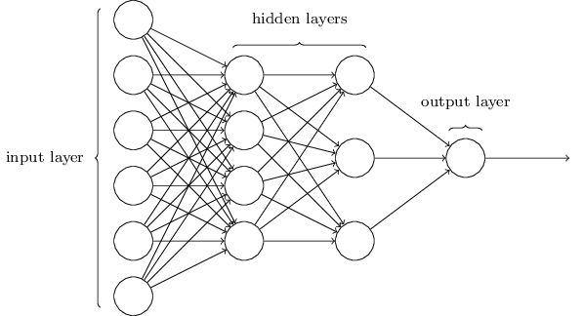
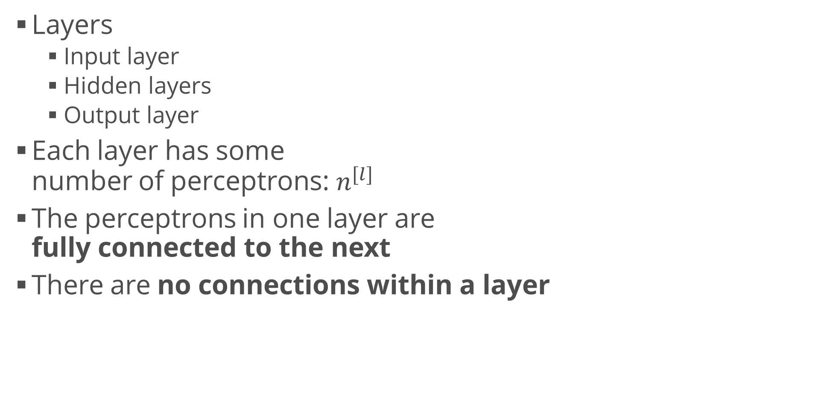
Neural Network
Layers
Input layer
Hidden layers
Output layer
Each layer has some number of perceptrons: $n^{[l]}$
The perceptrons in one layer are fully connected to the next
There are no connections within a layer

Slide 26
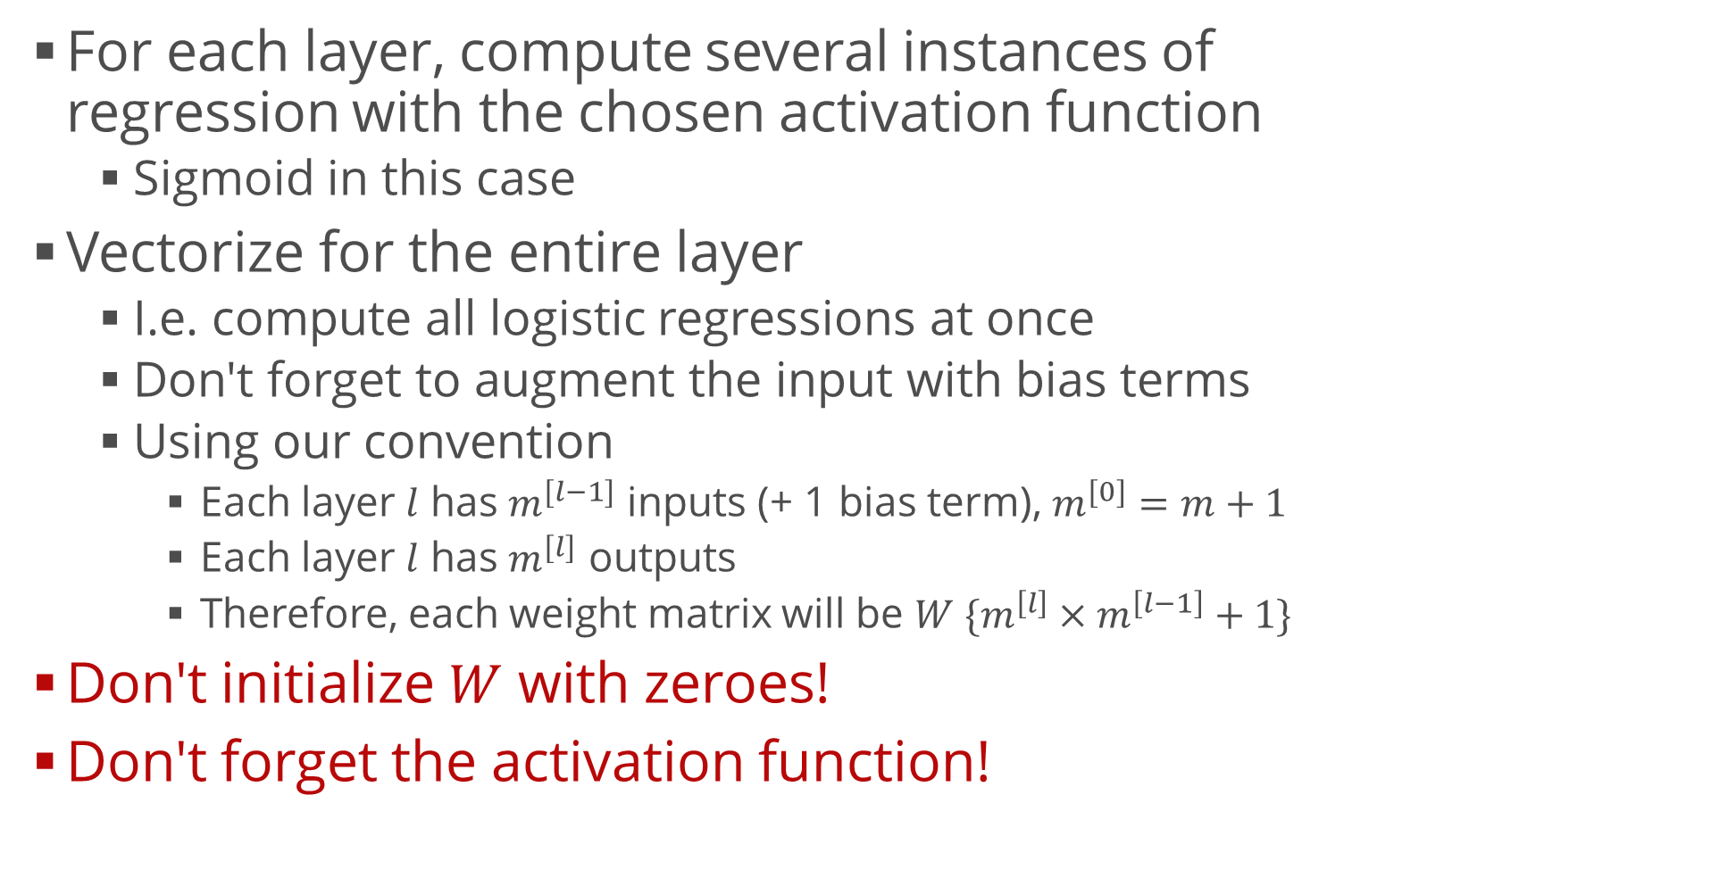
Neural Network Implementation
For each layer, compute several instances of regression with the chosen activation function
Sigmoid in this case
Vectorize for the entire layer
I.e. compute all logistic regressions at once
Don't forget to augment the input with bias terms
Using our convention
Each layer $l$ has $m^{[l−1]}$ inputs (+ 1 bias term), $m^{[0]}=m+1$
Each layer $l$ has $m^{[l]}$ outputs
Therefore, each weight matrix will be $W \{m^{\left[l\right]}×m^{\left[l−1\right]}+1\}$
Don't initialize $W$ with zeroes!
Don't forget the activation function!

Slide 27
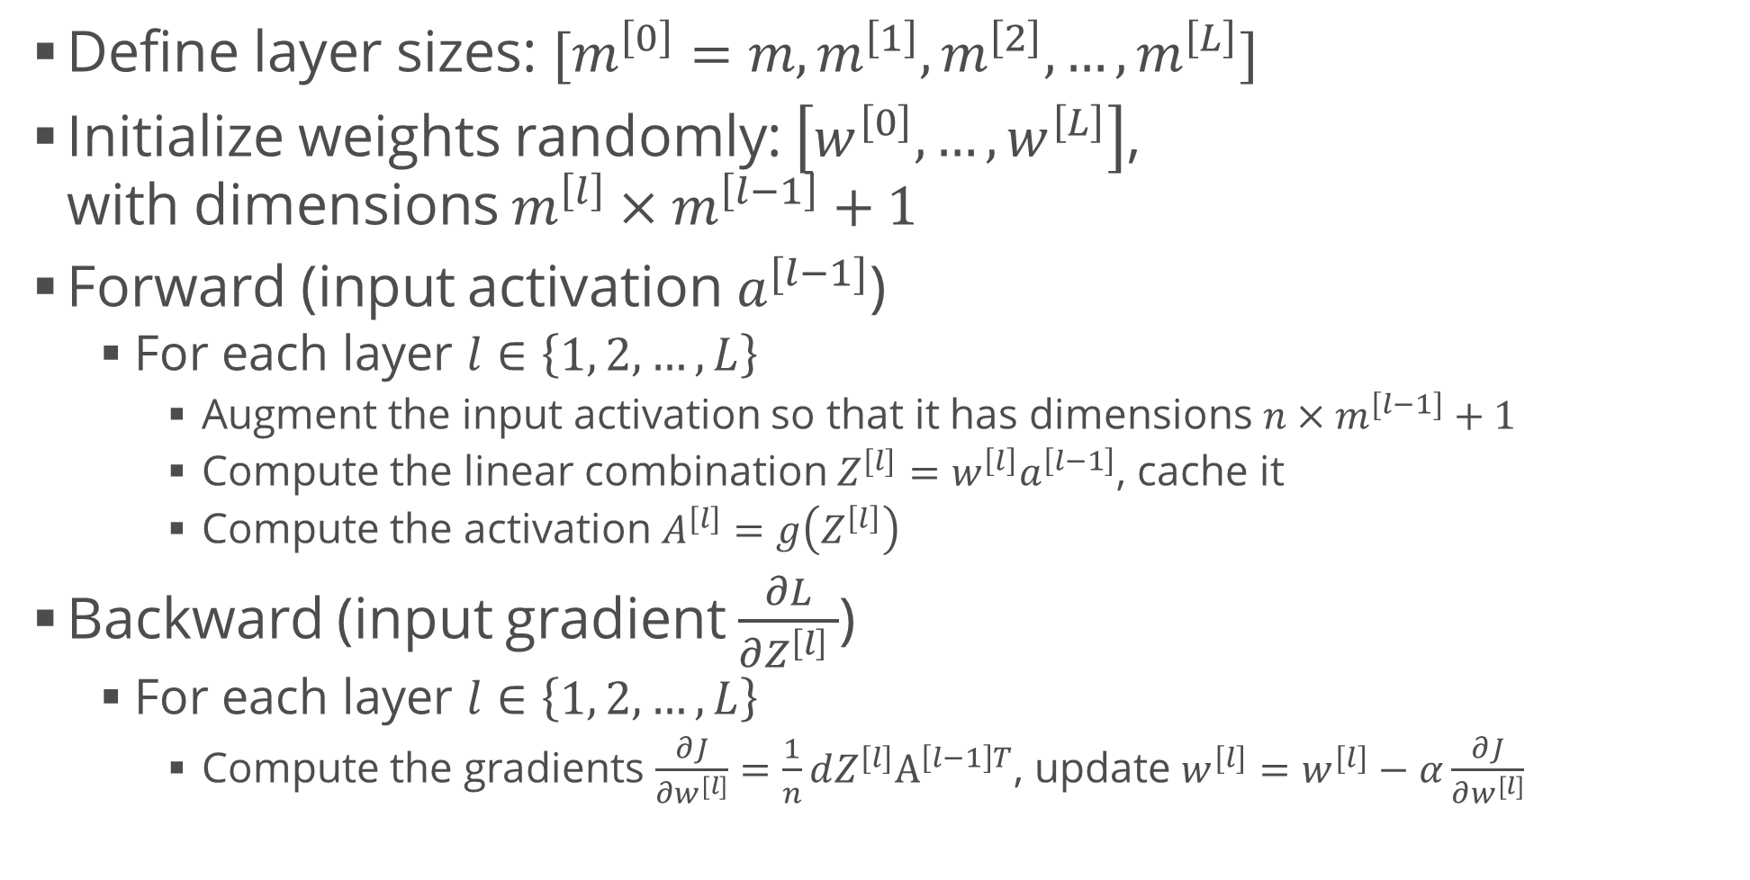
Neural Network Implementation (2)
Define layer sizes: $[m^{\left[0\right]}=m, m^{\left[1\right]}, m^{\left[2\right]}, …, m^{\left[L\right]}]$
Initialize weights randomly: $\left[w^{\left[0\right]}, …, w^{\left[L\right]}\right]$, with dimensions ${m^{\left[l\right]}×m}^{\left[l−1\right]}+1$
Forward (input activation $a^{[l−1]}$)
For each layer $l∈\left\{1, 2, …, L\right\}$
Augment the input activation so that it has dimensions $n×m^{[l−1]}+1$
Compute the linear combination $Z^{[l]}=w^{\left[l\right]}a^{\left[l−1\right]}$, cache it
Compute the activation $A^{[l]}=g\left(Z^{\left[l\right]}\right)$
Backward (input gradient $\frac{∂L}{∂Z^{\left[l\right]} }$)
For each layer $l∈\left\{1, 2, …, L\right\}$
Compute the gradients $\frac{∂J}{∂w^{[l]}}=\frac{1}{n}dZ^{[l]}A^{\left[l−1\right]T}$, update $w^{[l]}=w^{[l]}−α\frac{∂J}{∂w^{[l]}}$

Slide 28
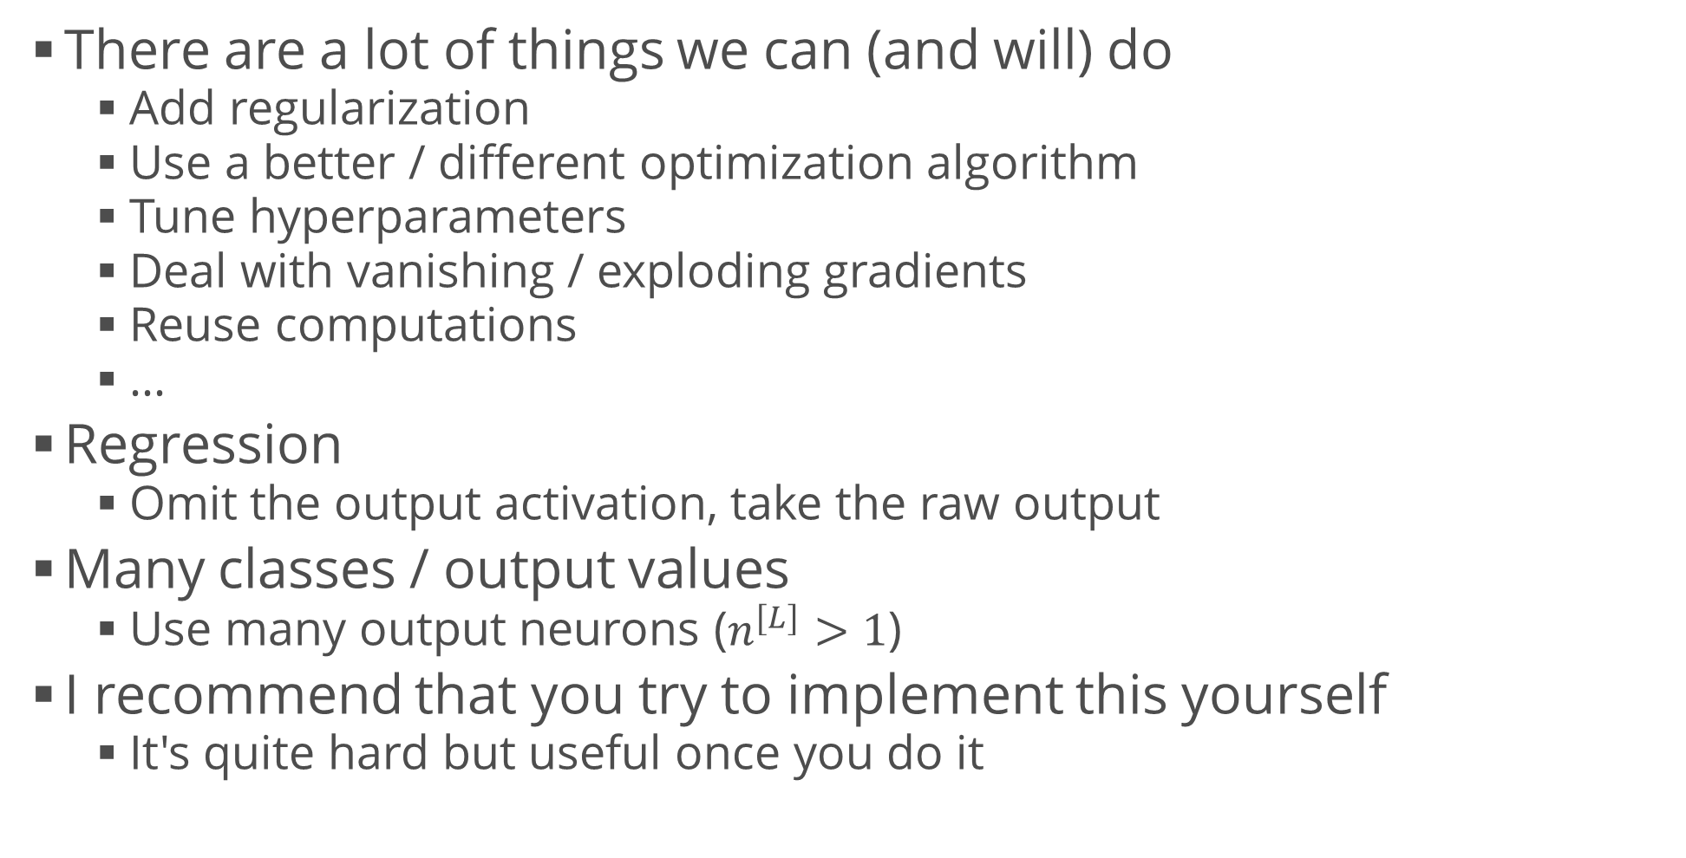
Extensions
There are a lot of things we can (and will) do
Add regularization
Use a better / different optimization algorithm
Tune hyperparameters
Deal with vanishing / exploding gradients
Reuse computations
…
Regression
Omit the output activation, take the raw output
Many classes / output values
Use many output neurons ($n^{[L]}>1$)
I recommend that you try to implement this yourself
It's quite hard but useful once you do it

Slide 29
Summary
Neural networks
Overview
Problem statement
Pros and cons
Perceptron
Feed-forward NNs (multi-layer perceptrons)
Training
Applications for classification

